Slide 1
7-Protocols and Standards
Computer Networks
1

Slide 2
What Is A Protocol?
A protocol is an agreement on how to communicate
A protocol is a set of rules that control data communication
Language that a computer uses to achieve data communication
Key elements of the protocol are syntax, semantics, and flow control.
2

Slide 3
What Is A Protocol?
Syntax
How a communication is specified & structured
Format, order messages are sent and received
For example, a some protocol might expect the first 8 bits of data to be the address of the sender, the second 8 bits to be the address of the receiver, and the rest of the stream to be the message itself.
3

Slide 4
What Is A Protocol?
Semantics
What a communication means (meaning of each section of bits)
Actions taken on transmitting and receiving
How are a particular pattern to be understood, and what action is to be taken based on that understanding?
For example, does an address identify the final destination of the message?
4

Slide 5
What Is A Protocol?
Flow Control
Have two attributes: When data should be sent and how fast they can be sent
For Example, if a sender produces data at 100 Mbps but the receiver can process data at only 1 Mbps, the transmission will overload the receiver and some data will be lost.
5

Slide 6
Protocol “layers”
Networks are complex, with many“pieces”:
Tasks involve varieties of hardware and software components, and protocols
hosts
routers
links of various media
applications
protocols
hardware, software

Slide 7
Design Issues for the Layers
Addressing
Error Control
Flow Control
Routing

Slide 8
What Is A Layers?
To reduce design complexity, Networking task is divided into several subtasks or organized as a stack of levels called layer.
Each layer uses the services of the layer below it
Each layer offers some services to the layer above it

Slide 9
What Is A Layers?
The concept of layering is used in daily life

Slide 10










Postal System
Verify postage
“Route” letter
Take letter to local
post office
Write address
Put stamp
Close envelop
Drop letter
Take letter to destination’s postal office
Check address
Open envelope
Take letter to destination
Check destination address
10

Slide 11
Protocol Standardization
Ensure communicating hosts speak the same protocol
Help ensure that devices from different manufacturers can be integrated
Key role in growth of networks and network devices
14

Slide 12
ISO (International Organization for Standardization)
Establishes communications and networking standards
Known for its contributions to network protocol standards

Slide 13
Standard Protocol Architectures
Two approaches (standard)
OSI Reference model
Never used widely
But well known
TCP/IP protocol suite
Most widely used
16

Slide 14
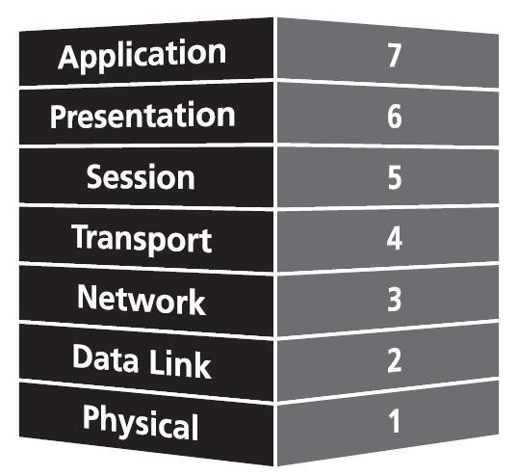
OSI - The Layer Model
Each layer has specific functions and it is responsible
All layers work together in the correct order to move data around a network
Top to bottom – All People Seem To Need Data Processing
14

Slide 15
OSI Model (Open Systems Interconnection)
The OSI model is a layered framework for the design of network systems that allows communication between all types of computer systems
It consists of seven separate but related layers
Each layer defines a part of the process of moving information across a network
An OSI model provides a solid basis for understanding data communications
Developed by the International Organization for Standardization (ISO)
15

Slide 16

Seven Layers of the OSI Model
Application
Application (Upper) Layers
Presentation
Session
Transport
Network
Data Flow Layers
Data-Link
Physical
16

Slide 17
Horizontal and Vertical Communication between layers
Horizontal communication within OSI layers refers to communication between entities at the same layer, facilitating the exchange of control information or data processing tasks.
Vertical communication involves interaction between adjacent layers, where each layer provides services to the layer above and receives services from the layer below, ensuring end-to-end data transfer and protocol adherence.

Slide 18
Horizontal Communication
The horizontal communication is the Logical connection between the layers
There is no direct communication between them
Information included in each protocol header by the transmitting system is a message that will be carried to the same protocol in the destination system

Slide 19
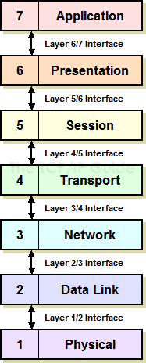
Vertical Communication
The header information also enables each layer to communicate with the layer above & below it.
This interlayer communication is called vertical communication

Slide 20
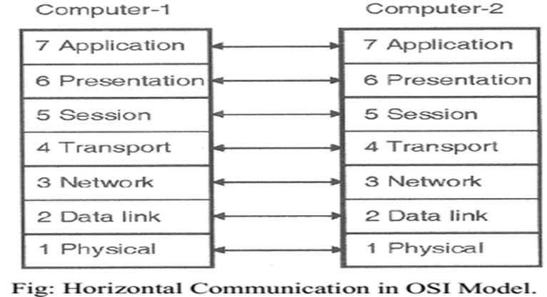
Horizontal Communication
When the packet reaches at its destination, the process by which the headers are applied at the source is reversed in receiver to get information

Slide 21
Protocol Data Units (PDU)
User data is passed from layer to layer
Control information is added/removed to/from user data at each layer
Header (and sometimes trailer)
Each layer has a different header/trailer
Data + header + trailer = PDU (Protocol Data Unit)
Each layer has a different PDU
Headers are located at the beginning of a data unit and contain control information, while trailers are located at the end and primarily serve for error detection and correction

